Slide 1
Cyber Threat Analytics Platform with Incident Visualization System

Slide 2
Project Overview
Analyzes cybersecurity incidents using Power BI.
Classifies threats and analyzes their severity.
Studies geographical and temporal incident patterns.
Evaluates incident response and resolution performance.
Assesses security risks and operational vulnerabilities.
Provides predictive and executive-level security insights.

Slide 3
Data & Technologies
Datasets
Security Incidents
Incident Response
Asset Inventory
Location and Date information
Environmental/Context data where required
Tools
Microsoft Power BI
Power Query
DAX
Microsoft Excel

Slide 4
Project Methodology
↓ ↓ ↓ ↓ ↓ ↓
Data Collection
Data Cleaning & Transformation
Data Modeling
DAX Measures & KPIs
Dashboard Development
Risk & Predictive Analysis
Executive Decision Support

Slide 5
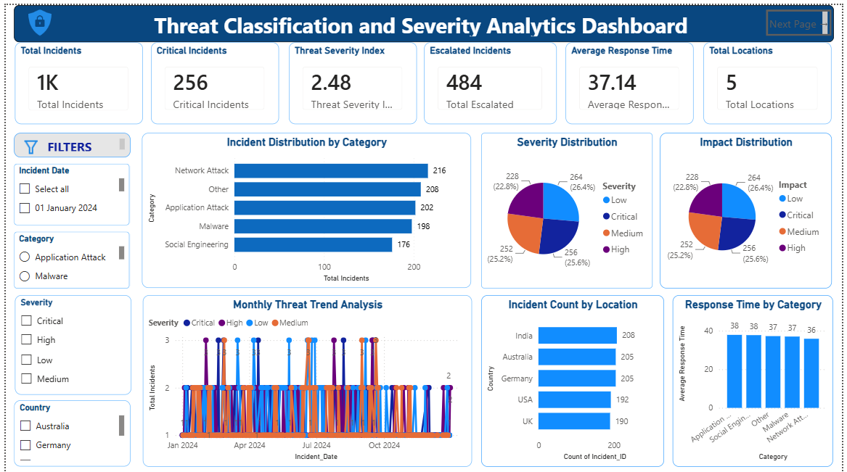
Milestone 1 – Threat Classification & Severity Analytics
Analyzed cybersecurity incidents by threat category.
Studied severity levels of incidents.
Created important KPI cards.
Analyzed incident trends and geographical distribution.
Analyzed response indicators.
Added interactive slicers for detailed analysis.
Key Focus
Threat → Severity → Response → Location

Slide 6
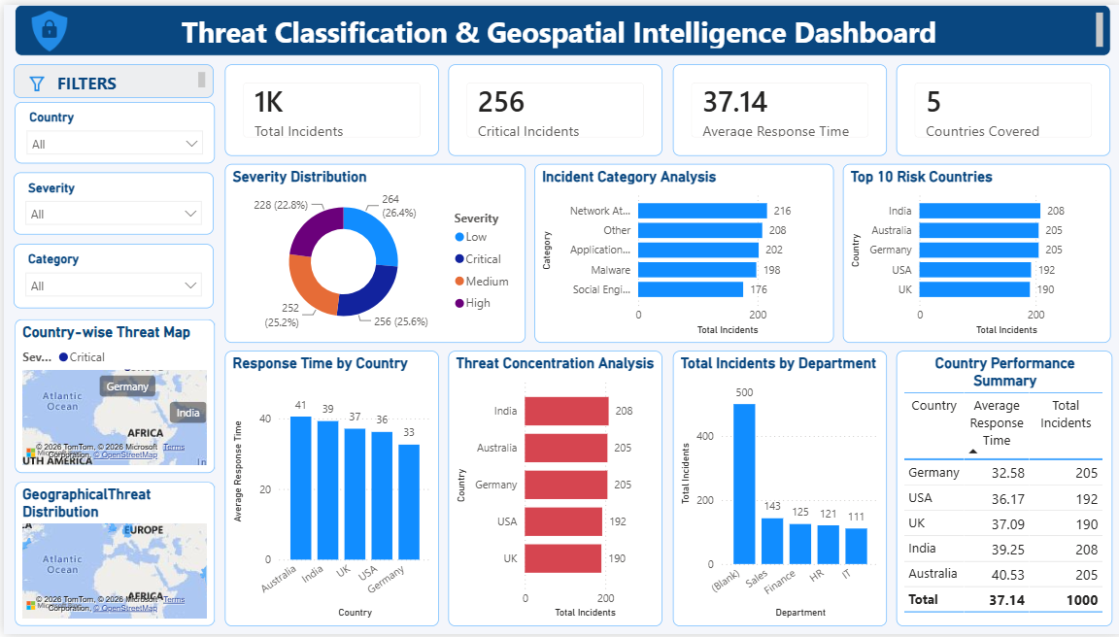
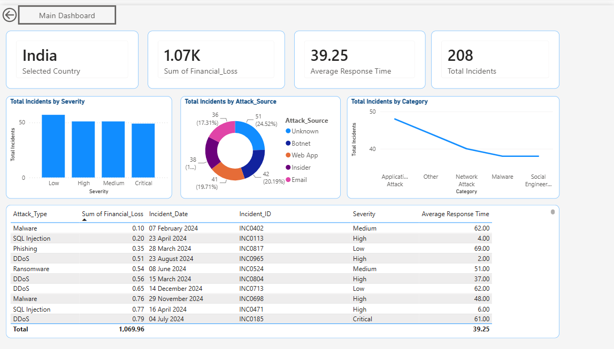
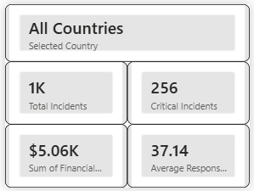
Milestone 2 – Geospatial Intelligence
Analyzed incidents geographically.
Used Bubble Map and Filled Map.
Identified Top Risk Cities.
Compared response time across locations.
Studied threat concentration.
Added drill-through and tooltips.
Used interactive location, severity and category filters.
Key Focus
Where are the threats concentrated?

Slide 7
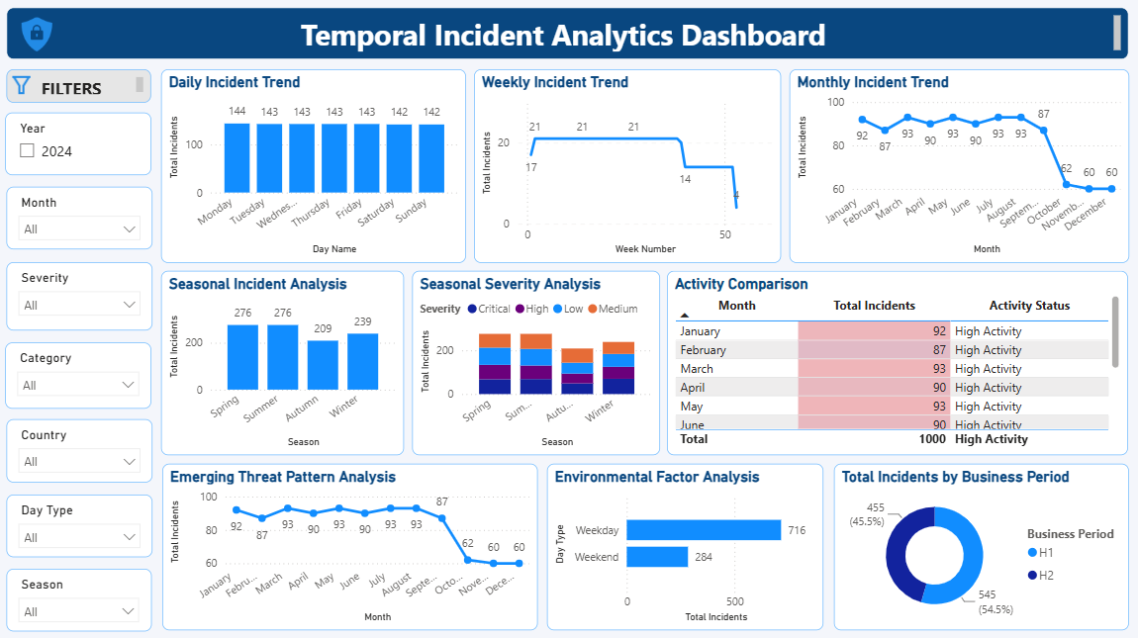
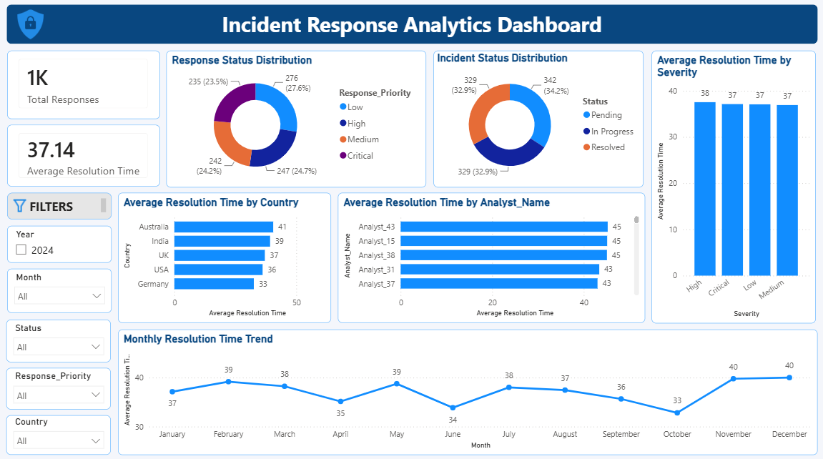
Milestone 3 – Temporal & Incident Response Analytics
Analyzed incidents across different time periods.
Studied hourly, daily, weekly and monthly trends.
Identified seasonal patterns and incident spikes.
Analyzed emerging threat patterns.
Studied environmental/context factors.
Compared response and resolution performance.
Analyzed Open vs Closed incidents.
Key Focus
When do incidents occur and how effectively are they handled?

Slide 8
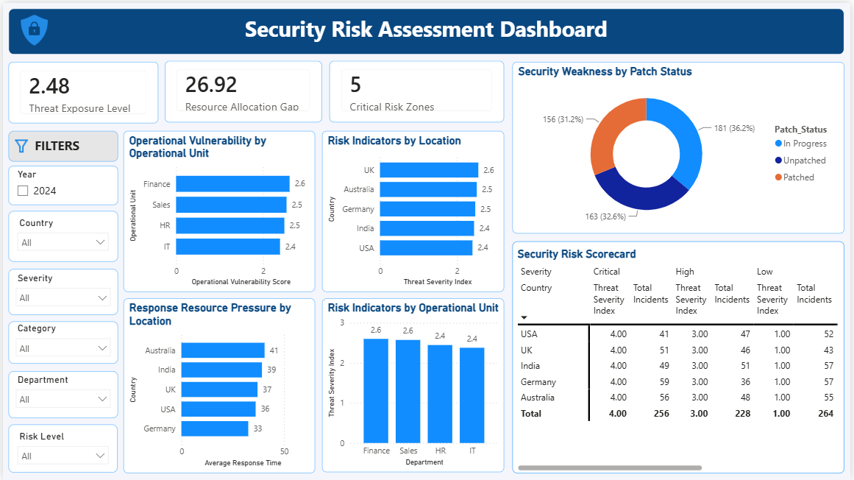
Milestone 4 – Security Risk Assessment
Measured Threat Exposure.
Analyzed Operational Vulnerability.
Compared risk across locations and operational units.
Identified Resource Allocation Gaps.
Identified security weaknesses.
Analyzed patch status.
Analyzed response resource pressure.
Generated a Security Risk Scorecard.
Key Focus
What is the current security risk?

Slide 9
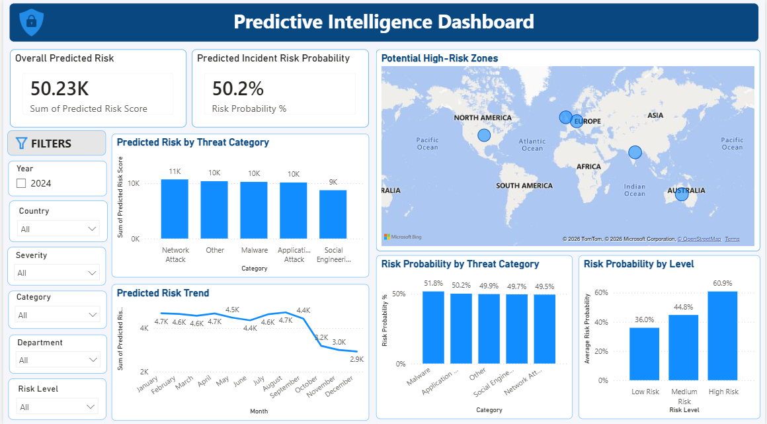
Predictive Intelligence & Executive Analytics
Predictive Intelligence
Overall Predicted Risk
Incident Risk Probability
Predicted Risk by Threat Category
Predicted Risk Trend
Potential High-Risk Zones
Risk Probability by Threat Category
Risk Probability by Risk Level

Slide 10
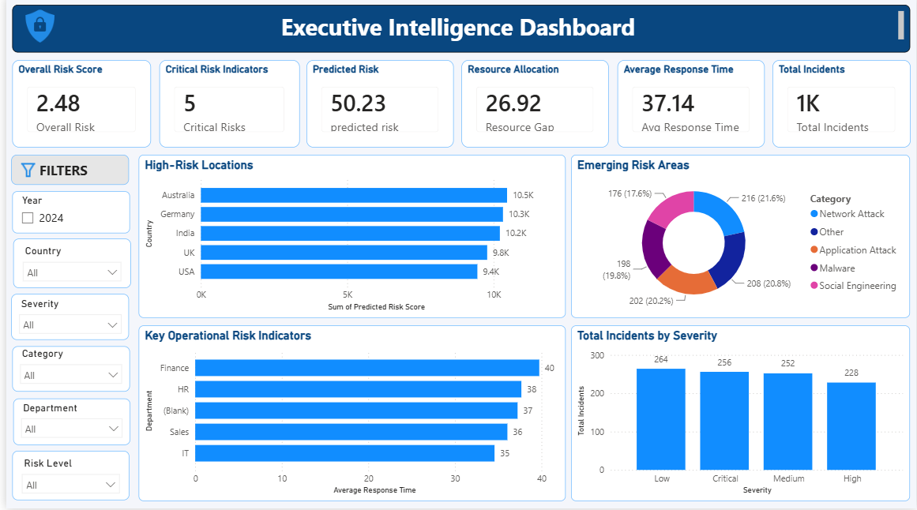
Executive Analytics
Overall Risk Score
Critical Risk Indicators
Predicted Risk
Resource Allocation
Average Response Time
High-Risk Locations
Emerging Risk Areas
Operational Risk Indicators

Slide 11
Key Outcomes
Identified major threat and severity patterns.
Identified geographical risk areas.
Analyzed incident trends and response performance.
Identified operational vulnerabilities.
Assessed current security risks.
Added predictive risk analysis.
Identified potential high-risk zones.
Created executive decision-support dashboards.

Slide 12
Conclusion
Our project provides a complete view of cybersecurity incidents and risks.
We analyzed threats, severity, locations, trends and response performance.
We identified current security risks and operational vulnerabilities.
Predictive analysis helped identify potential future risks and high-risk areas.
The executive dashboard provides important insights for better security decisions.

Slide 13
THANK YOU

